Slide 1
Noughts and crosses
Presented by:
Reema Prajapati
Bina Balami
Sandhya Gauro
Priyanka Gyawali

Slide 2
What’s the idea?
Development of two-player board game.
Rules.
Other variants.

Slide 3
How did we do it?
C++ programming language
- purpose multi-paradigm programming language
Code::blocks IDE
- full-featured IDE aiming to make the individual developer work in a nice programming environment

Slide 4
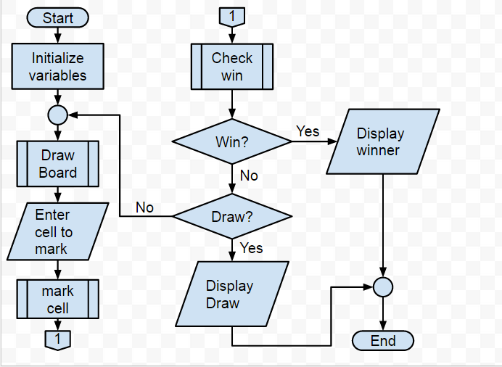
How does it work?

Slide 5
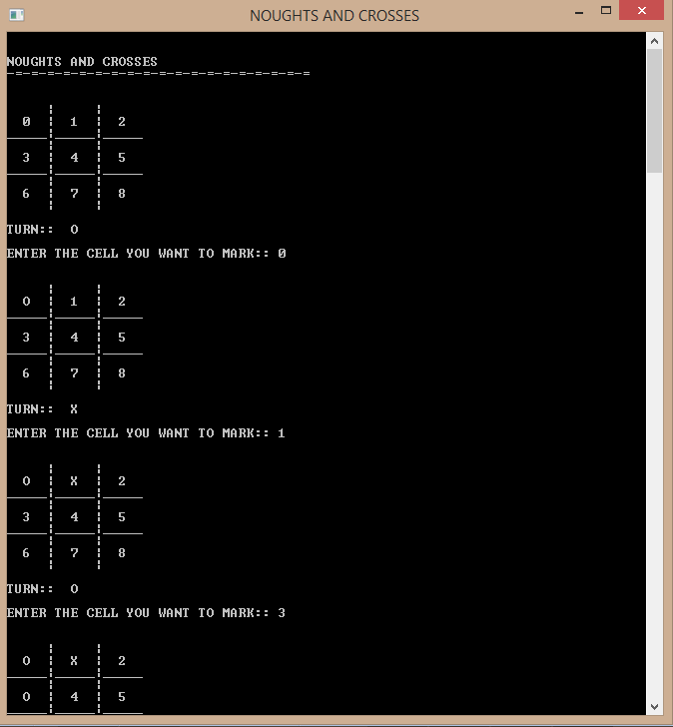
How does it look?

Slide 6
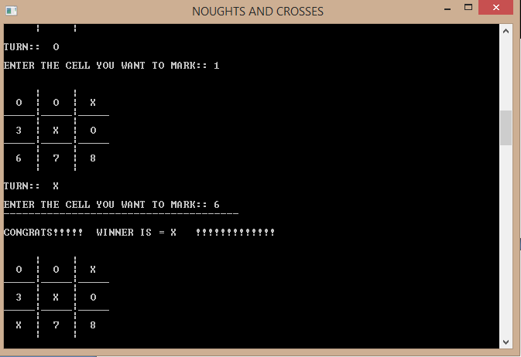
How does it look?

Slide 7
What can’t it do?
Simplest form of Noughts and Crosses.
Lacks implementation of audio and visual effects
Only played between any two users.

Slide 8
conclusion
Hence, this project is successfully completed and the game was developed with a simple user-interface that can be played between any two users.

Slide 9
Thank you! ☺

